Slide 1
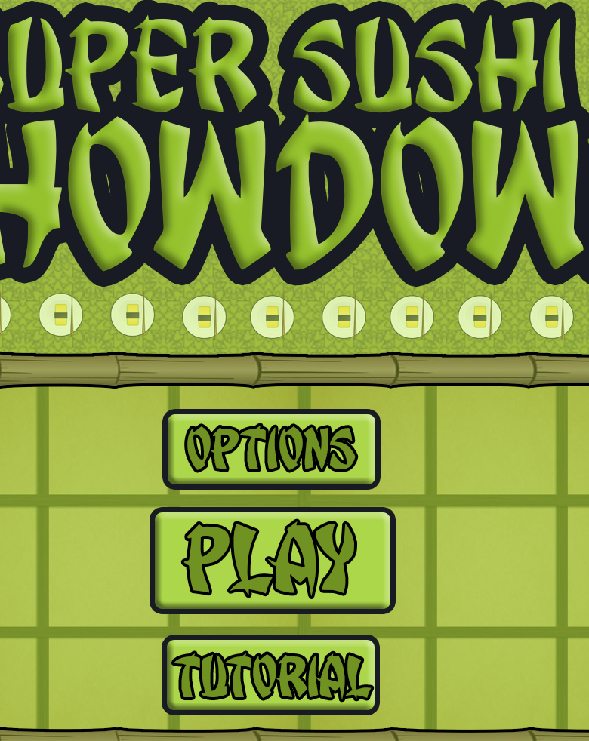
Bandai Namco Group 5 Second Pitch
Super Sushi Showdown
Henry Crofts, Ashley Long, Samuel McMillan and Dawid Hojka

Slide 2
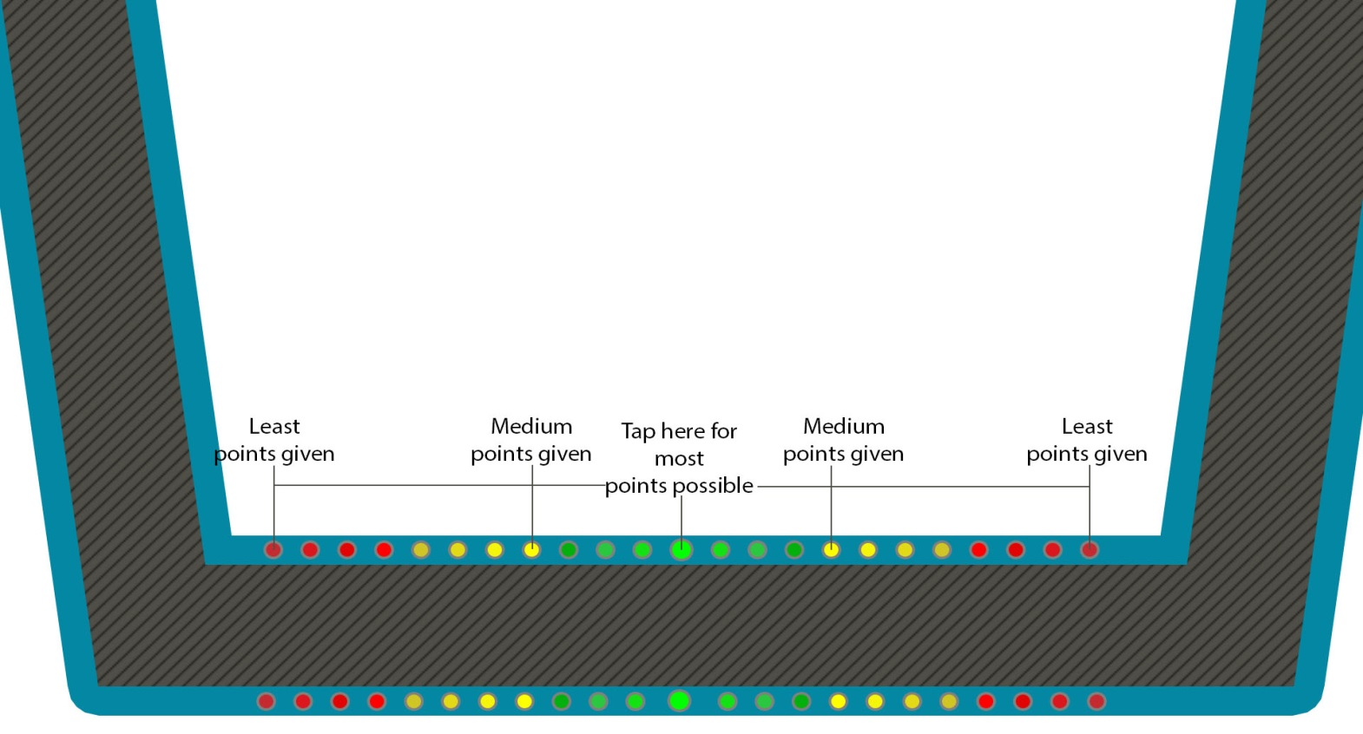
Brief Overview
Turn based
Adversarial
Twitch

Slide 3
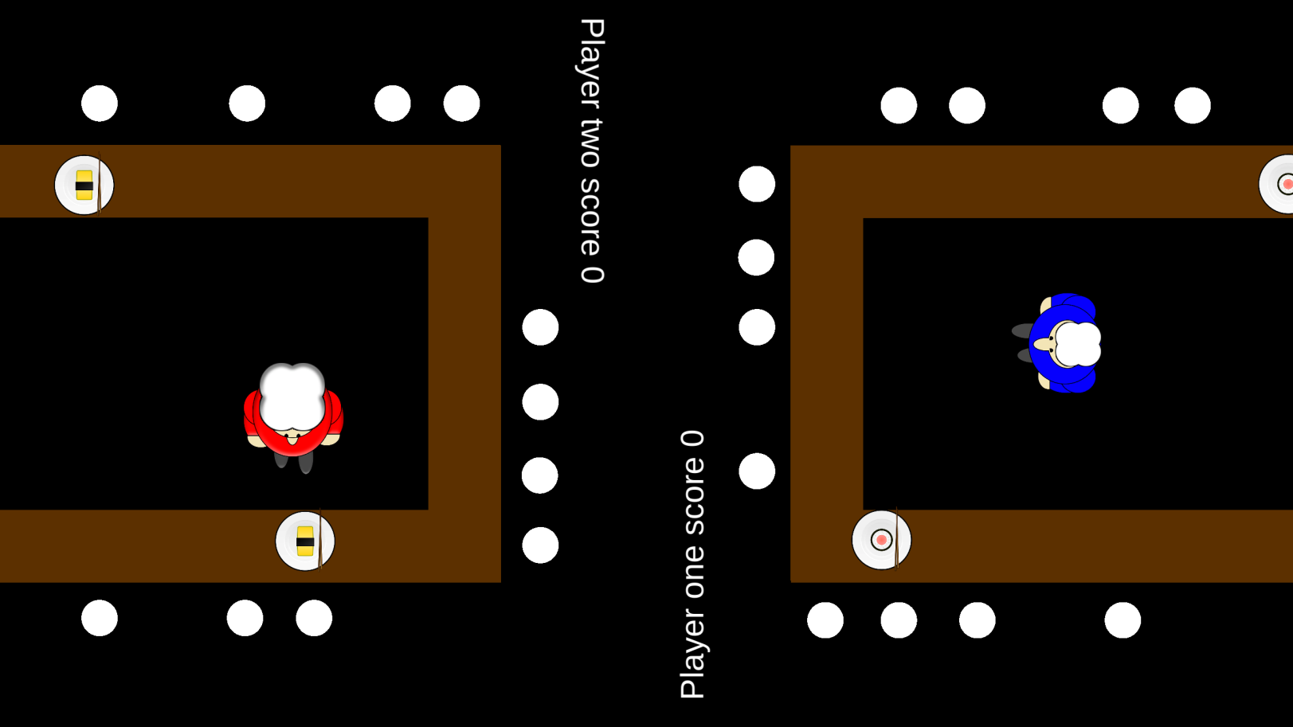

Latest Prototype / Features

Slide 4


What does the player do?
Core game loop
Player one begins play
Completes order
Turns switched
Win Condition

Slide 5
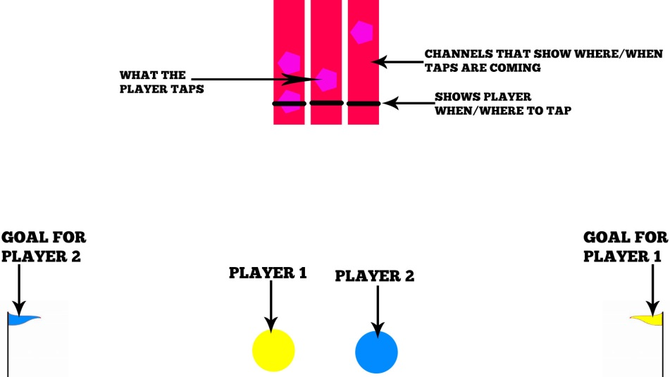

Iterations
Reverse Tug of War / Twitch
Tap falling nodes
Highest score wins round
Side view

Slide 6

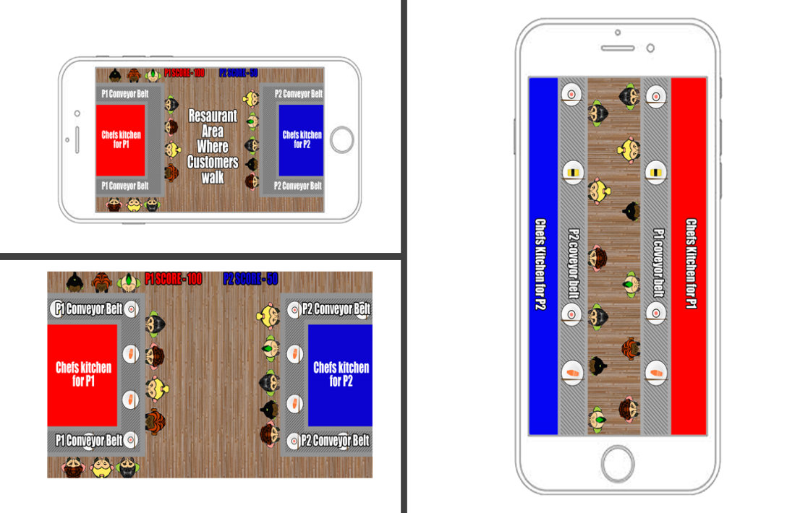
Iterations Continued
Sushi theme
Bring nodes into game
Screen space
Adversarial

Slide 7
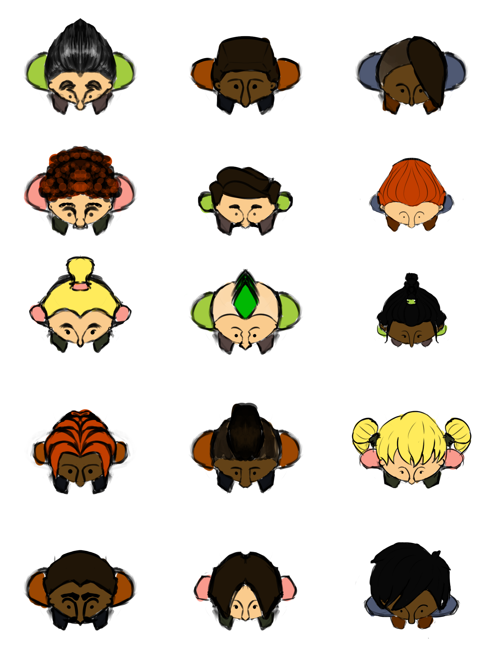

Where is the fun?
Hard fun: Frustration, fiero
People fun: Competition, schadenfreude
Serious fun: Flow state, repetition

Slide 8
Critiques
Interaction between two players
Speed increase
Power Ups

Slide 9


Questions?

